Slide 1
International Data Encryption Algorithm (IDEA)
IDEA: Primitive operations- Key expansions- One round, Odd round, Even Round- Inverse keys for decryption. AES: Basic Structure- Primitive operation- Inverse Cipher- Key Expansion, Rounds, Inverse Rounds. Stream Cipher –RC4.

Slide 2
Detailed description of IDEA
IDEA operates with 64-bit plaintext and cipher text blocks and is controlled by a 128-bit key Completely avoid substitution boxes and table lookups used in the block ciphers.
The algorithm structure has been chosen such that when different key sub-blocks are used, the encryption process is identical to the decryption process

Slide 3
Overview
DES algorithm has been a popular secret key encryption algorithm and is used in many commercial and financial applications.
However, its key size is too small by current standards and its entire 56 bit key space can be searched in approximately 22 hours.
IDEA is a block cipher designed by Xuejia Lai and James L. Massey in 1991
It is a minor revision of an earlier cipher, PES (Proposed Encryption Standard)
IDEA was originally called IPES (Improved PES) and was developed to replace DES

Slide 4
Overview (cont’)
It entirely avoids the use of any lookup tables or S-boxes
IDEA was used as the symmetric cipher in early versions of the Pretty Good Privacy cryptosystem

Slide 5
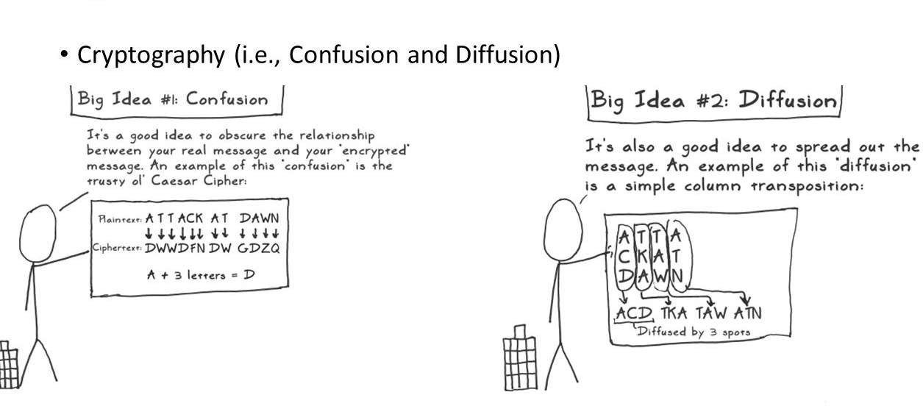

Slide 6
IDEA
International Data Encryption Algorithm
Symmetric block cipher
128 bit key
Encrypt data in blocks of 64 bits

Slide 7
Cryptographic Strength
Block Length:64 bits
Key Length :128 bits
Confusion
Diffusion

Slide 8
IDEA Encryption
plaintext – 64 bits
Key – 128 bits
8 rounds followed by a final transformation function
Sub key size :16 bits
52 sub keys required
Each of the rounds makes use of six 16 bit subkeys, where as the final transformation uses four subkeys, for a total of 52 sub keys

Slide 9
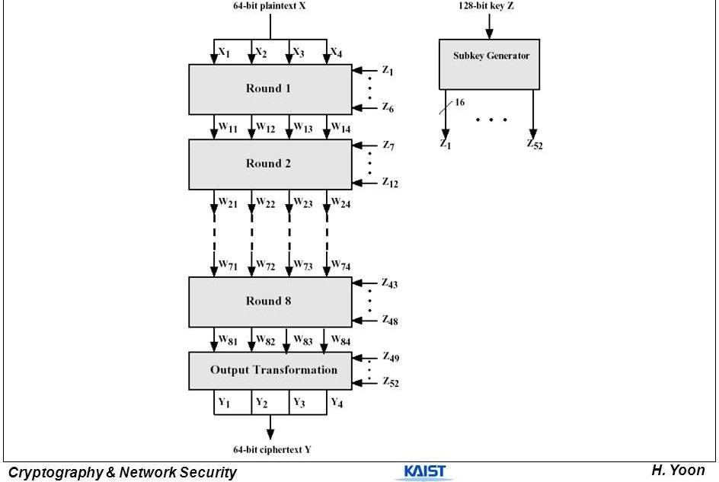

Slide 10
Diffusion
Provided by the basic building block of algorithm known as Multiplication Addition Structure.
Takes as inputs two 16 bit values derived from plaintext & two 16 bit subkeys derived from the key.
Produces two 16-bit outputs
This structure is repeated 8 times in algorithm
Provides very effective diffusion

Slide 11
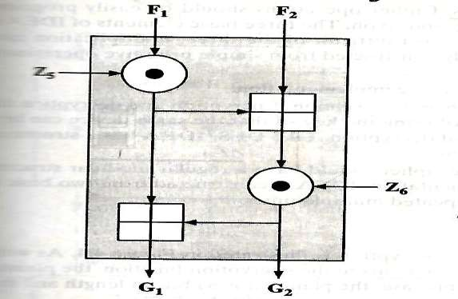
Multiplication Addition (MA) Structure

Slide 12
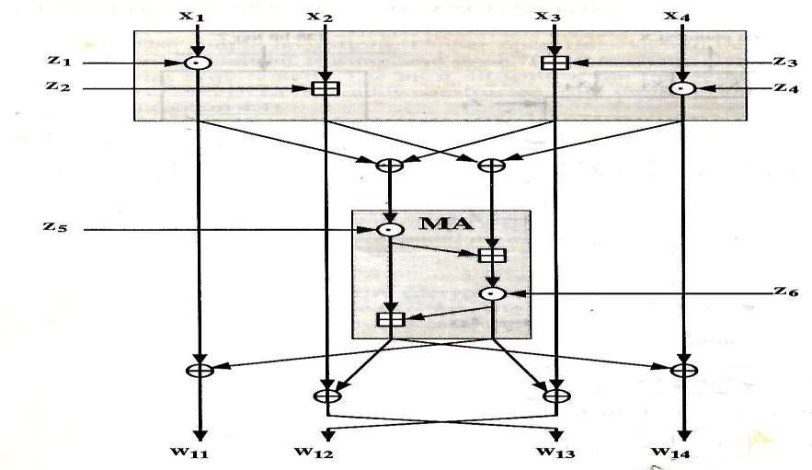
Details of a Single Round- Odd Round

Slide 13
Details of a Single Round- Odd Round (1)
Round begins with a transformation
That combines four input subblocks with four subkeys
Using the addition & multiplication operations
Four output blocks produce by this transformation are then combined using the XOR operation to form two 16 bit blocks that are input to the MA structure.

Slide 14
Details of a Single Round- Odd Round (2)
MA structure also takes two subkeys as input
Combines these inputs to produce two 16-bit outputs
Finally the 4 output blocks from the upper transformation are combined with the two output blocks of MA structure using XOR to produce the 4 output blocks for this round.
Second & third inputs are interchanged to produce the second & third output (w₁₂ & w₁₃)

Slide 15
Even Round
Subsequent rounds have the same structure but with different subkey & plaintext derived inputs

Slide 16
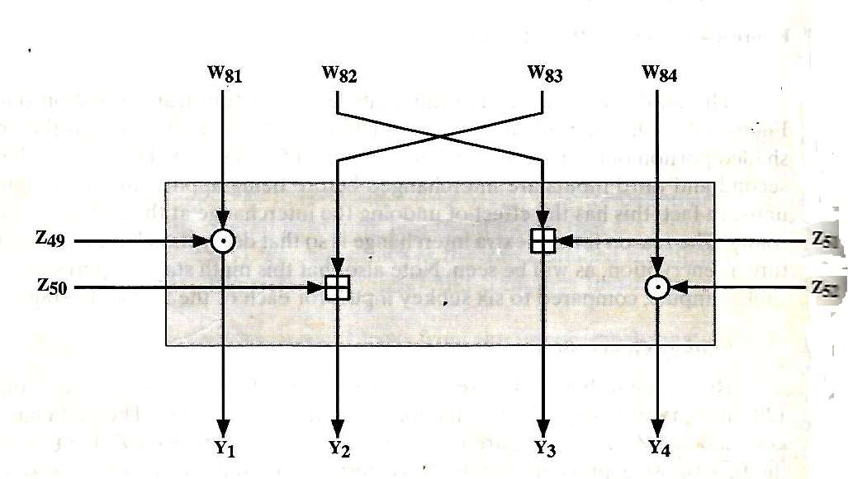
Ninth stage – output Transformation Stage

Slide 17
Ninth stage – output Transformation Stage
Second & third inputs are interchanged before being applied to the operational units

Slide 18
Subkey Generation
52, 16 bit subkeys are generated from 128-bit encryption key
First eight subkeys, labeled Z₁,Z₂,……….,Z₈ are taken directly from the key
Z₁ being equal to the first 16 bits
Z₂ being equal to the next 16 bits
Then a circular left shift of 25 bit positions is applied to the key & the next 8 subkeys are extracted
This procedure is repeated untill all 52 subkeys are generated.

Slide 19
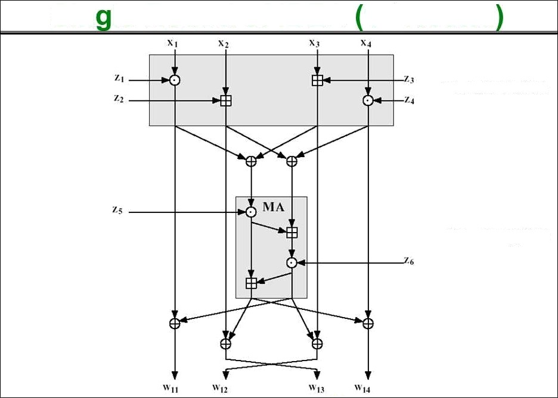

Sin le Round of IDEA 1st Round
Conventional Rnciyprron: Algorithms
10
Transformation
Sub-encryption
Cryptograpfiy & I\Network Securfiy

Slide 20
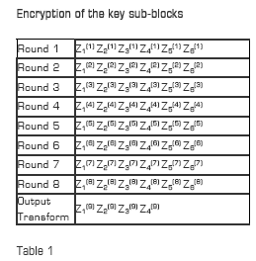

Slide 21
Encryption of the key sub-blocks
The key sub-blocks used for the encryption and the decryption in the individual rounds are shown in Table 1

Slide 22
Decryption
The computational process used for decryption of the ciphertext is essentially the same as that used for encryption
The only difference is that each of the 52 16-bit key sub-blocks used for decryption is the inverse of the key sub-block used during encryption
In addition, the key sub-blocks must be used in the reverse order during decryption in order to reverse the encryption process

Slide 23
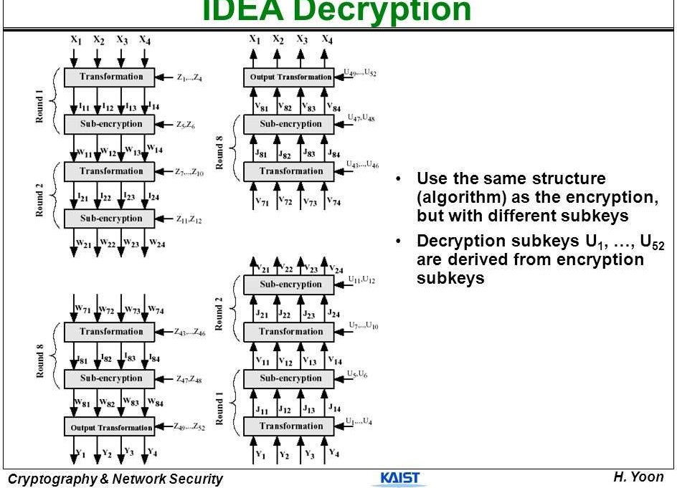

Slide 24
Strengths of IDEA Encryption:
IDEA encryption offers a number of strengths, which include:
Strong Security: IDEA encryption uses a 128-bit key, making it extremely difficult to crack. It is also resistant to differential and linear attacks.
Fast Encryption: IDEA encryption is a fast encryption algorithm, making it ideal for use in real-time applications.
Simple Design: IDEA encryption uses a simple design, making it easy to implement and use.

Slide 25
Weaknesses of IDEA Encryption:
IDEA encryption also has a few weaknesses, which include:
Vulnerable to Brute-Force Attacks: Although IDEA encryption is considered secure, it is still vulnerable to brute-force attacks.
Limited Key Size: IDEA encryption uses a 128-bit key, which is smaller than some other encryption algorithms.

Slide 26
Applications of IDEA Encryption:
IDEA encryption has a wide range of applications, including:
Secure Communication: IDEA encryption can be used to secure communication between two parties, such as in email or instant messaging applications.
Data Storage: IDEA encryption can be used to encrypt sensitive data stored on a hard drive or other storage devices.
Digital Signatures: IDEA encryption can be used to create digital signatures, which can be used to verify the authenticity of digital documents.

